Slide 1

SOCIONICS
All slides are copyrighted by Jack Oliver Aaron of the World Socionics Society
A CRASH COURSE

Slide 2
4. FUNCTIONS
Part II
All slides are copyrighted by Jack Oliver Aaron of the World Socionics Society

Slide 3
SO FAR
All slides are copyrighted by Jack Oliver Aaron of the World Socionics Society
Information Elements
Information Metabolism
Function Dichotomies

Slide 4
TODAY
All slides are copyrighted by Jack Oliver Aaron of the World Socionics Society
Functions of Model A
Function Interactions
Function Transitions

Slide 5
MODEL A - 8 FUNCTIONS
All slides are copyrighted by Jack Oliver Aaron of the World Socionics Society
Block | Dimension | Approach | Function | No.
Ego | 4D | Assertive | Leading | 1
Ego | 3D | Collaborative | Creative | 2
Super-Ego | 2D | Reluctant | Role | 3
Super-Ego | 1D | Intransigent | Vulnerable | 4
Super-Id | 1D | Collaborative | Suggestive | 5
Super-Id | 2D | Assertive | Mobilising | 6
Id | 3D | Intransigent | Ignoring | 7
Id | 4D | Reluctant | Demonstrative | 8

Slide 6
MODEL A - 8 FUNCTIONS
All slides are copyrighted by Jack Oliver Aaron of the World Socionics Society
1. Leading | 2. Creative
4. Vulnerable | 3. Role
6. Mobilising | 5. Suggestive
7. Ignoring | 8. Demonstrative
Ego
Super-Ego
Super-Id
Id

Slide 7
MODEL A - 8 FUNCTIONS
All slides are copyrighted by Jack Oliver Aaron of the World Socionics Society
1. | 2.
4. | 3.
6. | 5.
7. | 8.
Blocking of functions within Block by default, e.g 1+2.
May Block vertically, 2+3, but does not feel natural
Vertical blocking sometimes necessary

Slide 8
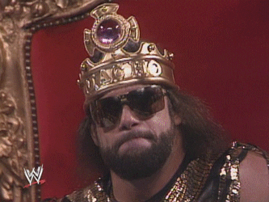
1 - LEADING FUNCTION
All slides are copyrighted by Jack Oliver Aaron of the World Socionics Society
1 | 2
4 | 3
6 | 5
7 | 8
Ego, 4D and Assertive
Sets why we do what we do
Assumes others view the world similarly
Takes precedence, decides our priorities
Master of the psyche, calls the shots

Slide 9
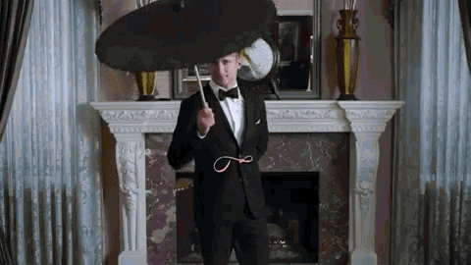
2 - CREATIVE FUNCTION
All slides are copyrighted by Jack Oliver Aaron of the World Socionics Society
1 | 2
4 | 3
6 | 5
7 | 8
Ego, 3D and Collaborative
Implements the Leading’s program
Gives it a distinct flavour or focus
Adapts and adjusts itself without fuss
Helpful sidekick, follows orders with skill

Slide 10
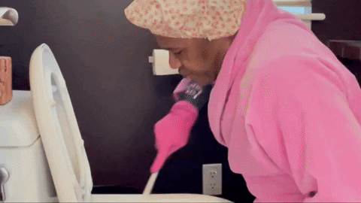
3 - ROLE FUNCTION
All slides are copyrighted by Jack Oliver Aaron of the World Socionics Society
1 | 2
4 | 3
6 | 5
7 | 8
Super-Ego, 2D and Reluctant
The “act” we feel made to put on
Uncomfortable to use, crude and inconsistent
Responds to risks and external expectations
Fails if supported by Vulnerable

Slide 11

4 - VULNERABLE FUNCTION
All slides are copyrighted by Jack Oliver Aaron of the World Socionics Society
1 | 2
4 | 3
6 | 5
7 | 8
Super-Ego, 1D and Intransigent
The blind spot we cannot use properly
Beyond our understanding or appreciation
Totally rejected and avoided
Refuses to support the Role

Slide 12
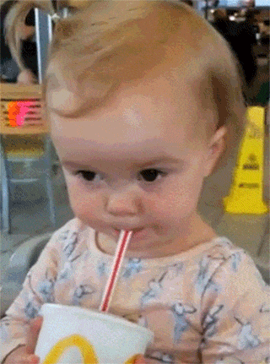
5 - SUGGESTIVE FUNCTION
All slides are copyrighted by Jack Oliver Aaron of the World Socionics Society
1 | 2
4 | 3
6 | 5
7 | 8
Super-Id, 1D and Collaborative
Unfulfilled needs we know not how to satisfy
Naturally complements the Leading function
Lacks confidence, seeks guidance from others
Where true pain and vulnerability can be felt

Slide 13
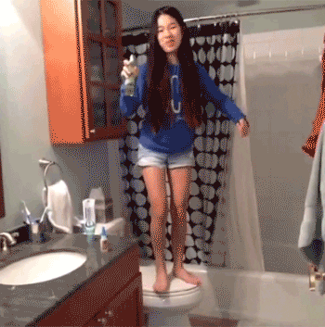
6 - MOBILISING FUNCTION
All slides are copyrighted by Jack Oliver Aaron of the World Socionics Society
1 | 2
4 | 3
6 | 5
7 | 8
Super-Id, 2D and Assertive
Aspirations and areas of personal growth
How we would like to be
Must prove itself to support the Suggestive
Often overconfident and can backfire

Slide 14
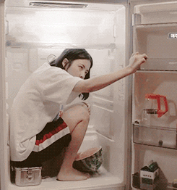
7 - IGNORING FUNCTION
All slides are copyrighted by Jack Oliver Aaron of the World Socionics Society
1 | 2
4 | 3
6 | 5
7 | 8
Id, 3D and Intransigent
Suppressed by Leading, kept in a cage
Only used when necessary to the 1.
Seen as the “backward” or “wrong” thing to do
Expertly unused until let out the cage

Slide 15
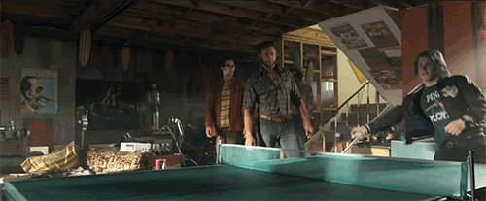
8 - DEMONSTRATIVE FUNCTION
All slides are copyrighted by Jack Oliver Aaron of the World Socionics Society
1 | 2
4 | 3
6 | 5
7 | 8
Id, 4D and Reluctant
Highly active, often feeding 2
As strong as Leading but not taken seriously
Taken entirely for granted, used to relax
Returned to when confidence is low

Slide 16

HOW FUNCTIONS CONNECT
All slides are copyrighted by Jack Oliver Aaron of the World Socionics Society
Interactions | Transitions
Functions playing together Between inverse Functions If Stubborn, then competitive If Flexible, then collaborative Valued reins over Neglected | Movements between Functions Between opposing Functions If Obvious, then explicit change If Subtle, then implicit default Goes from Constant to Variable

Slide 17
INTERACTIONS - Dichotomies in common
All slides are copyrighted by Jack Oliver Aaron of the World Socionics Society
Strong/Weak
Stubborn/Flexible
Demanding/Supplying
Elements are always the SAME Domain

Slide 18
4 Function Interactions
All slides are copyrighted by Jack Oliver Aaron of the World Socionics Society
 | Demanding | Supplying
Stubborn | 1+7 = Domination | 4+6 = Hubris
Flexible | 3+5 = Struggle | 2+8 = Mastery
 | Demanding | Supplying
Strong | 1+7 = Domination | 2+8 = Mastery
Weak | 3+5 = Struggle | 4+6 = Hubris

Slide 19
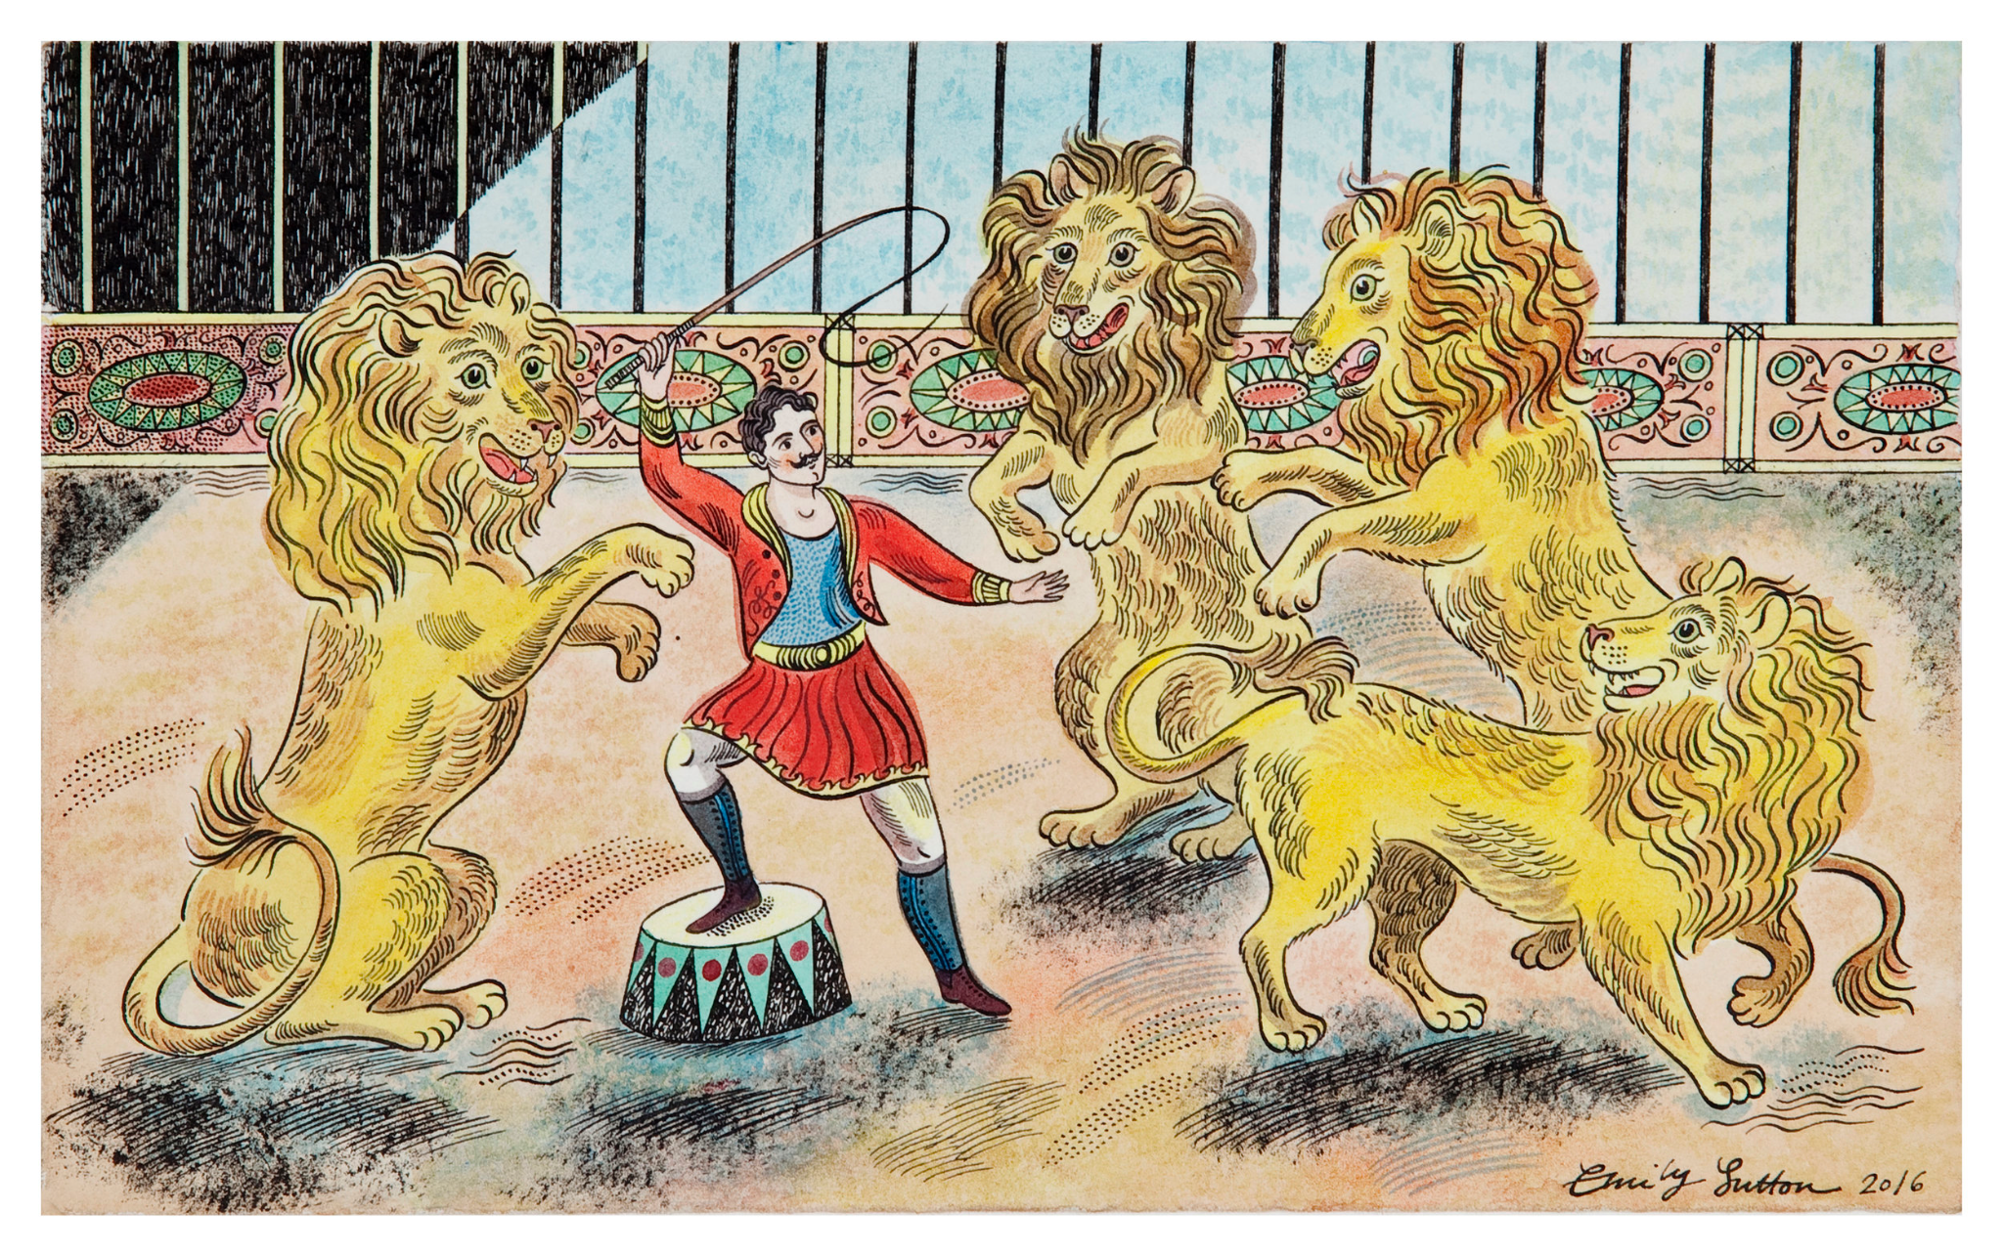
DOMINATION: LEADING & IGNORING
All slides are copyrighted by Jack Oliver Aaron of the World Socionics Society
1 | 2
4 | 3
6 | 5
7 | 8
Strong, Stubborn and Demanding
Area of total certainty and control
1 dominates 7
7 kept in a cage, let out when needed by 1

Slide 20
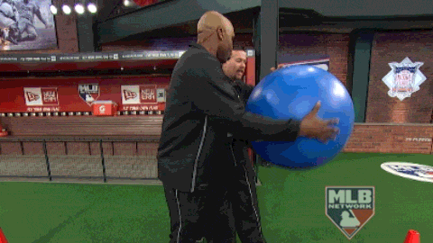
MASTERY: CREATIVE & DEMONSTRATIVE
All slides are copyrighted by Jack Oliver Aaron of the World Socionics Society
1 | 2
4 | 3
6 | 5
7 | 8
Strong, Flexible and Supplying
Area of resourceful adaptation
2 and 8 in fluid interplay
2 leads, but constantly fed by 8

Slide 21

STRUGGLE: ROLE & SUGGESTIVE
All slides are copyrighted by Jack Oliver Aaron of the World Socionics Society
1 | 2
4 | 3
6 | 5
7 | 8
Weak, Demanding and Flexible
Area of unwanted adaptation
5 desirable but not viable
3 undesirable but viable
Forced to use 3, until help received in 5

Slide 22
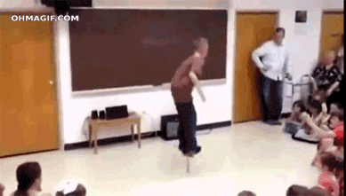
HUBRIS: VULNERABLE & MOBILISING
All slides are copyrighted by Jack Oliver Aaron of the World Socionics Society
1 | 2
4 | 3
6 | 5
7 | 8
Weak, Supplying and Stubborn
Area of overconfident striving and failure
6 flies too close to sun, overplays its hand
Blindness to 4 trips up 6 in big crash

Slide 23
TRANSITIONS - Dichotomies in common
All slides are copyrighted by Jack Oliver Aaron of the World Socionics Society
Public/Private
Obvious/Subtle
Demanding/Supplying

Slide 24
4 Function Transitions
All slides are copyrighted by Jack Oliver Aaron of the World Socionics Society
 | Demanding | Supplying
Public | 1+3 = Masking | 2+4 = Substitution
Private | 5+7 = Distraction | 6+8 = Growth
 | Demanding | Supplying
Obvious | 1+3 = Masking | 6+8 = Growth
Subtle | 5+7 = Distraction | 2+4 = Substitution

Slide 25
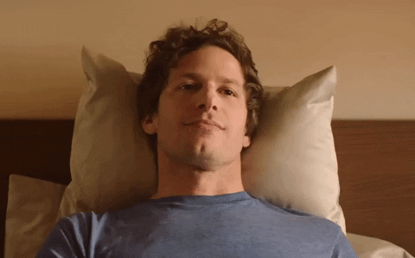
MASKING: LEADING -> ROLE
All slides are copyrighted by Jack Oliver Aaron of the World Socionics Society
1 | 2
4 | 3
6 | 5
7 | 8
Public, Obvious and Demanding
Unpleasant, unnatural adaptation
1 -> 3 in small pushes, then reverts
Lasts no longer than necessary
Success dependent on Vertical Blocking
Interfaces with Struggle interaction

Slide 26
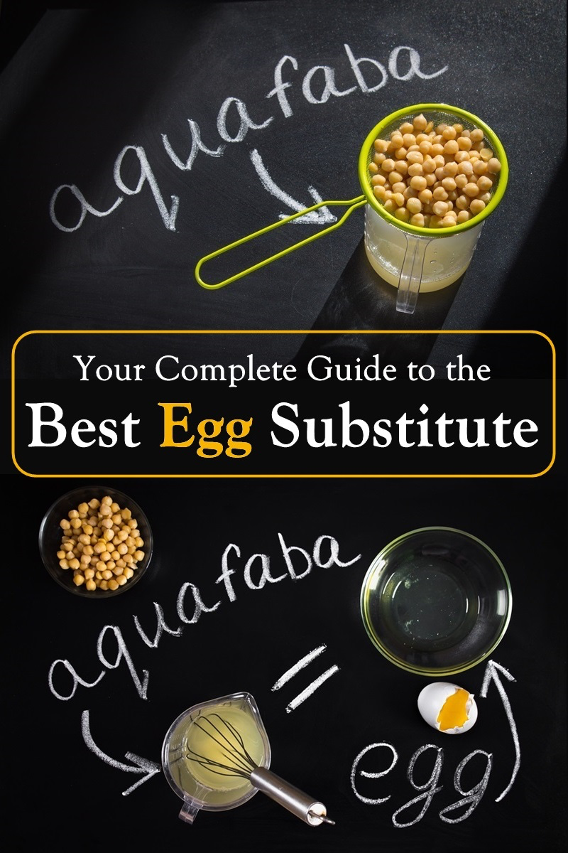
SUBSTITUTION: VULNERABLE -> CREATIVE
All slides are copyrighted by Jack Oliver Aaron of the World Socionics Society
1 | 2
4 | 3
6 | 5
7 | 8
Public, Subtle and Supplying
Compensates for cognitive absence
4 -> 2 by default
2 fills in the gaps left by 4
Sustains Mastery but ensures Hubris

Slide 27
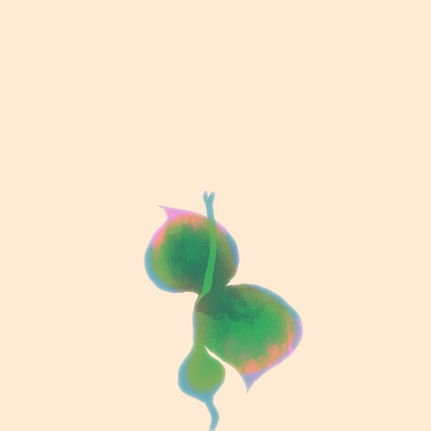
GROWTH: DEMONSTRATIVE -> MOBILISING
All slides are copyrighted by Jack Oliver Aaron of the World Socionics Society
1 | 2
4 | 3
6 | 5
7 | 8
Private, Obvious and Supplying
Low-stakes/reward to high-stakes/reward
8 -> 6 with growing confidence
Goes back to 8 confidence is broken, rinse/repeat
Suspends Mastery, undone by Hubris

Slide 28
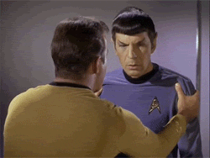
DISTRACTION: SUGGESTIVE -> IGNORING
All slides are copyrighted by Jack Oliver Aaron of the World Socionics Society
1 | 2
4 | 3
6 | 5
7 | 8
Private, Subtle and Demanding
Temporary sacrifice of need fulfilment
When necessary, 5 -> 7
Non-responsive to dual support when activated
Effect dissipates after use
Prevented by Domination, prolongs Struggle

Slide 29
INTERFACES
All slides are copyrighted by Jack Oliver Aaron of the World Socionics Society
Demanding
Supplying
Domination
Mastery
Masking
Distraction
Substitution
Growth
Struggle
Hubris

Slide 30
Shorthand Guide
All slides are copyrighted by Jack Oliver Aaron of the World Socionics Society
IM Element | Symbol | Shorthand
Force |  | F
Senses |  | S
Ideas |  | I
Telos |  | T
Pragmatism |  | P
Laws |  | L
Emotions |  | E
Relations |  | R
Function | Shorthand
Leading | 1
Creative | 2
Role | 3
Vulnerable | 4
Suggestive | 5
Mobilising | 6
Ignoring | 7
Demonstrative | 8

Slide 31
Full Type Conversion
Three Letter | Four Letter | Name | Model A
ILE | ENTP | The Inventor | I1, L2, F3, R4, S5, E6, T7, P8
SEI | ISFP | The Nurturer | S1, E2, T3, P4, I5, L6, F7, R8
ESE | ESFJ | The Host | E1, S2, P3, T4, L5, I6, R7, F8
LII | INTJ | The Analyst | L1, I2, R3, F4, E5, S6, P7, T8
EIE | ENFJ | The Icon | E1, T2, P3, S4, L5, F6, R7, I8
LSI | ISTJ | The Inspector | L1, F2, R3, I4, E5, T6, P7, S8
SLE | ESTP | The Conqueror | F1, L2, I3, R4, T5, E6, S7, P8
IEI | INFP | The Mystic | T1, E2, S3, P4, F5, L6, I7, R8
SEE | ESFP | The Opportunist | F1, R2, I3, L4, T5, P6, S7, E8
ILI | INTP | The Critic | T1, P2, S3, E4, F5, R6, I7, L8
LIE | ENTJ | The Entrepreneur | P1, T2, E3, S4, R5, F6, L7, I8
ESI | ISFJ | The Guardian | R1, F2, L3, I4, P5, T6, E7, S8
LSE | ESTJ | The Practitioner | P1, S2, E3, T4, R5, I6, L7, F8
EII | INFJ | The Counsellor | R1, I2, L3, F4, P5, S6, E7, T8
IEE | ENFP | The Explorer | I1, R2, F3, L4, S5, P6, T7, E8
SLI | ISTP | The Craftsman | S1, P2, T3, E4, I5, R6, F7, L8
Alpha
All slides are copyrighted by Jack Oliver Aaron of the World Socionics Society
Beta
Gamma
Delta

Slide 32
EXERCISE
All slides are copyrighted by Jack Oliver Aaron of the World Socionics Society
Write up the Model A for every type in the Socion.
Take a page of A4
Divide the page of A4 into 4 Quadras
Within each Quadra, draw 4 Model A rectangles with 8 inner squares
Write the name of each type under each Model A rectangle
Fill in the symbols for each IM Element assigned to each Function for each type

Slide 33
Any Questions?
All slides are copyrighted by Jack Oliver Aaron of the World Socionics Society
Email Jack at worldsocionics@hotmail.com

